Slide 1
Apache Spark
Prof Jigna Patel
CSE Department, Institute of Technology
Nirma University
Notes:
Data sharing is slow in MapReduce due to replication, serialization, and disk IO. Most of the Hadoop applications, they spend more than 90% of the time doing HDFS read-write operations.
Recognizing this problem, researchers developed a specialized framework called Apache Spark. The key idea of spark is Resilient Distributed Datasets (RDD); it supports in-memory processing computation. This means, it stores the state of memory as an object across the jobs and the object is sharable between those jobs. Data sharing in memory is 10 to 100 times faster than network and Disk.
Let us now try to find out how iterative and interactive operations take place in Spark RDD.

Slide 2
What is Spark?
Fast , expensive cluster computing system compatible with Apache Hadoop
Works with Hadoop supported storage system (HDFS,S3,Sequencefile,Avro,…)
Improves efficiency through:
In-memory computing primitives
General computation graphs
Improves usability through::
Rich API in Java, Scala, Python
Interactive shell

Slide 3
Key Features
Fast processing: The most important feature of Apache Spark that has made the big data world choosing this technology over others is its speed.
Big data is characterized by its volume, variety, velocity, value, and veracity due to which it needs to be processed at a higher speed.
Spark contains Resilient Distributed Datasets (RDDs) that save the time taken in reading and writing operations, and hence it runs almost 10–100 times faster than Hadoop.

Slide 4
Flexibility: Apache Spark supports multiple languages and allows developers to write applications in Java, Scala, R, or Python. Equipped with over 80 high-level operators, this tool is quite rich from this aspect
In-memory computing: Spark stores data in the RAM of servers, which allows it to access data quickly, and in-turn this accelerates the speed of analytics.
Real-time processing: Spark is able to process real-time streaming data. Unlike MapReduce, which processes the stored data, Spark is able to process the real-time data and hence is able to produce instant outcomes.

Slide 5
Better analytics: Contrasting to MapReduce that includes Map and Reduce functions, Spark has much more in store. Apache Spark comprises a rich set of SQL queries, Machine Learning algorithms, complex analytics, etc. With all these Spark functionalities, Big Data Analytics can be performed in a better fashion.
Compatibility with Hadoop: Spark is not only able to work independently; it can work on top of Hadoop as well. Not just this, it is certainly compatible with both versions of the Hadoop ecosystem.

Slide 6
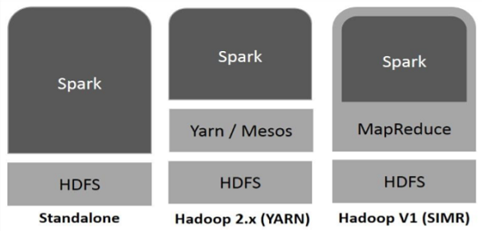
Spark Built on Hadoop
Notes:
There are three ways of Spark deployment as explained below.
Standalone − Spark Standalone deployment means Spark occupies the place on top of HDFS(Hadoop Distributed File System) and space is allocated for HDFS, explicitly. Here, Spark and MapReduce will run side by side to cover all spark jobs on cluster.
Hadoop Yarn − Hadoop Yarn deployment means, simply, spark runs on Yarn without any pre-installation or root access required. It helps to integrate Spark into Hadoop ecosystem or Hadoop stack. It allows other components to run on top of stack.
Spark in MapReduce (SIMR) − Spark in MapReduce is used to launch spark job in addition to standalone deployment. With SIMR, user can start Spark and uses its shell without any administrative access.

Slide 7
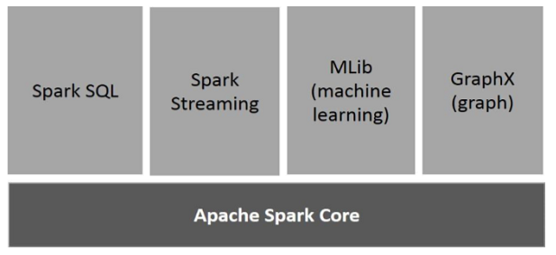
Components of Spark
Notes:
Apache Spark Core
Spark Core is the underlying general execution engine for spark platform that all other functionality is built upon. It provides In-Memory computing and referencing datasets in external storage systems.
Spark SQL
Spark SQL is a component on top of Spark Core that introduces a new data abstraction called SchemaRDD, which provides support for structured and semi-structured data.
Spark Streaming
Spark Streaming leverages Spark Core's fast scheduling capability to perform streaming analytics. It ingests data in mini-batches and performs RDD (Resilient Distributed Datasets) transformations on those mini-batches of data.
MLlib (Machine Learning Library)
MLlib is a distributed machine learning framework above Spark because of the distributed memory-based Spark architecture. It is, according to benchmarks, done by the MLlib developers against the Alternating Least Squares (ALS) implementations. Spark MLlib is nine times as fast as the Hadoop disk-based version of Apache Mahout (before Mahout gained a Spark interface).
GraphX
GraphX is a distributed graph-processing framework on top of Spark. It provides an API for expressing graph computation that can model the user-defined graphs by using Pregel abstraction API. It also provides an optimized runtime for this abstraction.

Slide 8
Two Main Abstractions of Apache Spark
RDD (Resilient Distributed Dataset)
DAG (Directed Acyclic Graph)

Slide 9
RDD is an immutable (read-only), fundamental collection of elements or items that can be operated on many devices at the same time (parallel processing). Each dataset in an RDD can be divided into logical portions, which are then executed on different nodes of a cluster.
DAG is the scheduling layer of the Apache Spark architecture that implements stage-oriented scheduling. Compared to MapReduce that creates a graph in two stages, Map and Reduce, Apache Spark can create DAGs that contain many stages.

Slide 10
Need Of Spark
Apache spark is a big data analytics framework that was originally developed at the University of California, Berkeley’s AMPLab, in 2012. Since then, it has gained a lot of attraction in both academia and in industry.
It is an another system for big data analytics
Isn’t Map Reduce good enough?
Simplifies batch processing on large commodity clusters

Slide 11
Need of Spark
MapReduce can be expensive for some applications
Iterative
Interactive
Lacks efficient data sharing
Specialized frameworks did evolve for different programming models
Bulk Synchronous Processing (Pregel)
Iterative MapReduce (Hadoop)…

Slide 12
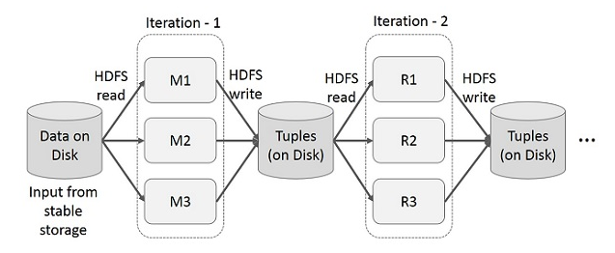
Iterative operations on MapReduce
Notes:
Reuse intermediate results across multiple computations in multi-stage applications. The following illustration explains how the current framework works, while doing the iterative operations on MapReduce. This incurs substantial overheads due to data replication, disk I/O, and serialization, which makes the system slow.

Slide 13
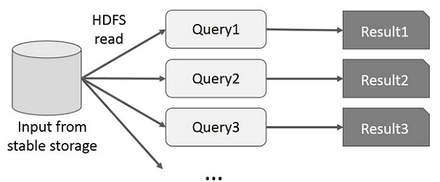
Interactive Operations on MapReduce
Notes:
User runs ad-hoc queries on the same subset of data. Each query will do the disk I/O on the stable storage, which can dominate application execution time.
The following illustration explains how the current framework works while doing the interactive queries on MapReduce.

Slide 14
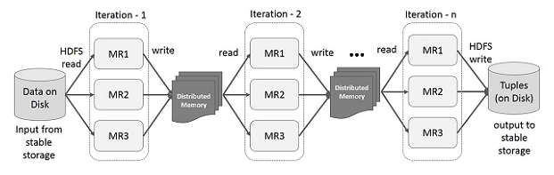
Iterative Operations on Spark RDD
Notes:
The illustration given below shows the iterative operations on Spark RDD. It will store intermediate results in a distributed memory instead of Stable storage (Disk) and make the system faster.
Note − If the Distributed memory (RAM) is not sufficient to store intermediate results (State of the JOB), then it will store those results on the disk.

Slide 15
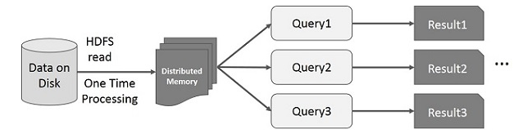
Interactive Operations on Spark RDD
Notes:
This illustration shows interactive operations on Spark RDD. If different queries are run on the same set of data repeatedly, this particular data can be kept in memory for better execution times.
By default, each transformed RDD may be recomputed each time you run an action on it. However, you may also persist an RDD in memory, in which case Spark will keep the elements around on the cluster for much faster access, the next time you query it. There is also support for persisting RDDs on disk, or replicated across multiple nodes.

Slide 16
Scala Vs Java APIs
Spark originally written in Scala, which allows concise function syntax and interactive use
APIs in Java, Scala and Python
Interactive shells in Scala and Python

Slide 17
Scala & Functional programming
High level language for the Java VM
Object-oriented + functional programming
Statically typed
Comparable in speed to Java
But often no need to write types due to type interface
Interoperates with Java
Can use any Java class, inherit from it, etc; can also call Scala code from Java

Slide 18
Declaring Variables
var X : Int =7
var x =7 //type inferred
val y = “hi” //read only
Java equivalent
int x =7;
final string y = “hi”

Slide 19
Functions
def square (x : Int) : Int =X*X
def square(x: Int) : Int ={ X* X}
def announce(test:string) { println(text) }
In Java
int square (int x) { return x*x)
void announce(String(text)) { System.out.println(text);}

Slide 20
Generic types
var arr = new Array [Int] (8)
var lst = List(1,2,3)
Indexing
arr(5) = 7
println(lst(s))

Slide 21
val list = List (1,2,3)
list.foreach(x=> println(x))
list.foreach(println)
list.map(x=>x+2)
list.map(_+2)
list.filter(x=>x%2==1)
list.filter(_%2==1)
list.reduce((x,y)=>x+y)
list.reduce(_+_)

Slide 22
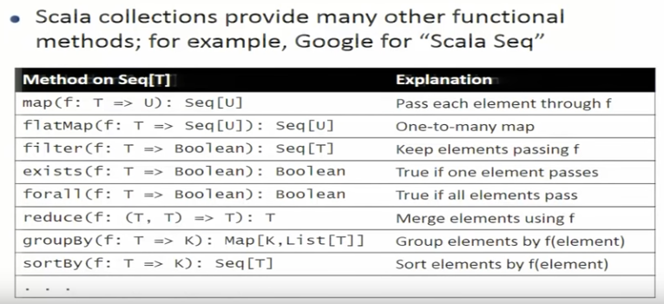

Slide 23
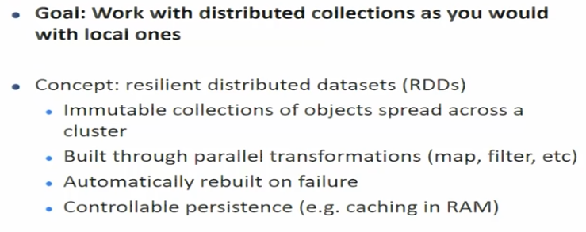
Spark Overview

Slide 24
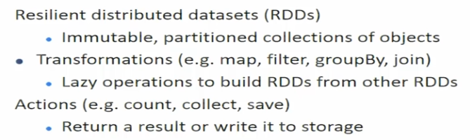
Main Primitives

